Slide 1
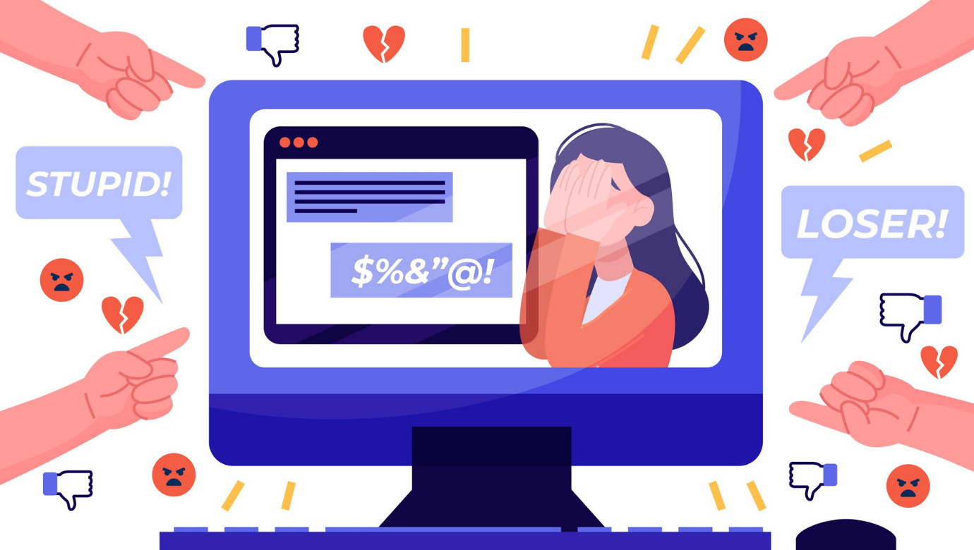
cyberbullying
Kliknite da biste dodali tekst

Slide 2
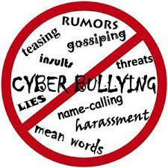
Mobitel i internet omogućuju stalnu dostupnost
Internet and your phone enable constant availability of information, to keep track of certain events, chatting, having fun with your friends, meeting new from all over the world, exchanging opinions and comments, playing video games with other players
But with each of these activities comes a possibility of you being hurt, or
upset or even talked into something inappropriate

Slide 3
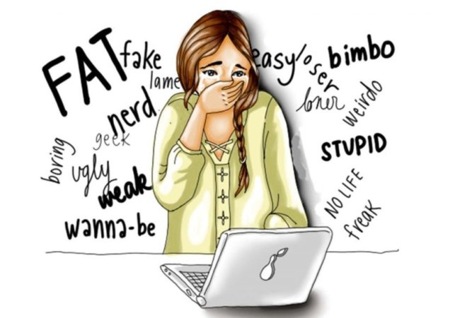
Humiliation, teasing, harassment, threats or hurting our feelings through the internet ( e-mails, social media, blogs ) or your phones in a form of text or video messages, photos, calls or inapropriate comments is called cyberbulling

Slide 4
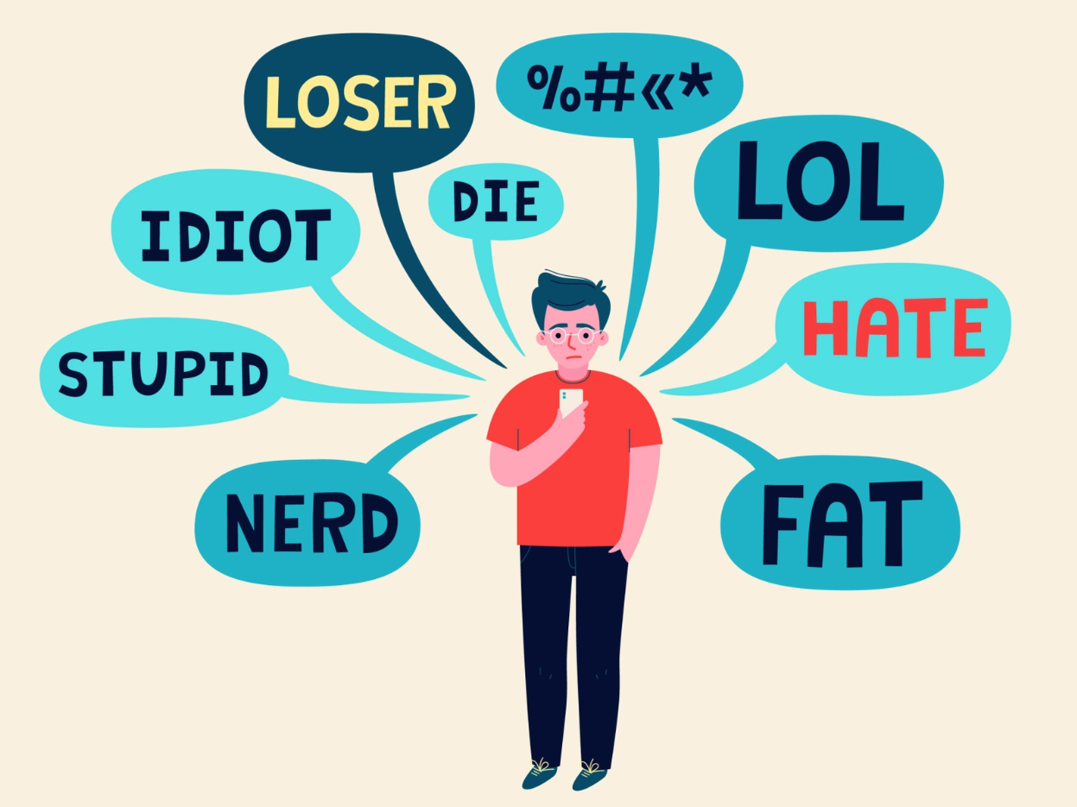

Slide 5
CYBERBULLING IS:
Sending disturbing and threatning messages
Persuasion on rejection and hatred
Posting personal details /secrets and untruths obout others
Breaking into other people's phones, emails, web sites and profiles on social media
Public posting of somone else's photos and encouraging its comments
revealing personal information about others
Giving unpleasant comments

Slide 6
Exposing to inapropriate contents
sending and sharing disturbing photos, viruses, pornography or spams
Taking on someone else's identity and posting text messages and photos pretending to be that person

Slide 7

WHY DOES CYBERBULLING
HAVE BIGGER IMPACT THEN
VIOLENCE IN REAL LIFE SITUATIONS
Every insult, threat or lie posted on internet stays available 24 hours a day, every day
Person is exposed to cyberbulling everywhere, to a wide audience and many witnesses

Slide 8
It intensifies the sence of insecurity and fear so the concequences of cyberbulling could become more serious then the ones caused by violence in a real-life situations
Since there is no physical contact it is more difficult to see and understand the damage the person is expriencing

Slide 9
RULES OF BEHAVIOR ON INtERNET
Do not post personal information and photos on any web sites
Do not give your passwords to others
When reciving a threatning message, do not answer, save the evidence and show to an adult you trust
Do not open an email from unknown address
Do not post on internet anything you don't want others to see
Every type of behavior that makes you uncomfortable
report it to an adult you trust

Slide 10
LEGAL CONCEQUENCES
Child's rights and freedoms are protected by a convention on the rights of a child that protects from the internet abuse as well
Some of the paragraphs of cyberbulling that subject to the criminal law are:
An insult ( acording to the same law ) - depreciation of another person or disrespect of his/her dignity
The insult is greater if it is published in the newspapers, radio, tv or on the internet because more people are included
Slander ( acording to the same law ) - making a false spoken statement damaging to a person's honor or reputetion, also greater when availble to a larger number of people

Slide 11
Revealing of information about a person or his/her family that can damage their honor or reputation is punishable by law
it is the right of every individual to be respected and not to depreciate his/her dignity
When children under 14 commit a crime , the police should notfy the social services, and they will carry out the procedure and impose a sentence if necessary

Slide 12
